Slide 1
Multiclass Fish Image Classification Deep Learning | Computer Vision
By Arjun

Slide 2
Objective
Develop a robust model to classify fish images into categories.
Compare custom CNN with pre-trained models for accuracy.
Deploy the best-performing model in an interactive web app.
Problem Statement
This project focuses on classifying fish images into multiple categories using deep learning models. The task involves training a CNN from scratch and leveraging transfer learning with pre-trained models to enhance performance. The project also includes saving models for later use and deploying a Streamlit application to predict fish categories from user-uploaded images.

Slide 3
Dataset Overview
Dataset Name: fish_dataset.zip Contents: Images organized by species folder Total Images: 10,514 Number of Classes: 11
Challenges:
Class imbalance
Variable image quality and size
Feature Type | Examples
Images | Raw fish photographs
Labels | Fish species (target)

Slide 4
Data Preprocessing & Augmentation
Rescaling: Normalize images to [0, 1] range.
Data Augmentation Techniques:
Rotation
Zoom
Horizontal & vertical flipping
Purpose:
Enhance model robustness
Prevent overfitting
Improve generalization

Slide 5
Model Training
Custom CNN: Train from scratch.
Pre-trained Models:
VGG16
ResNet50
MobileNetV2
InceptionV3
EfficientNetB0
Fine-tuning: Adapt pre-trained models to fish dataset.
Model Saving: Store the best model for future use (.h5 or .pkl).

Slide 6
Model Evaluation
Metrics Compared:
Visualize training/validation accuracy & loss
Compare model performance across architectures
Metric | Purpose
Accuracy | Overall correctness
Precision | Class-specific relevance
Recall | Class-specific completeness
F1-Score | Balance between precision & recall
Confusion Matrix | Analyze misclassifications

Slide 7
Model Performance Summary
Model | Accuracy | Precision | Recall | F1-Score
CNN (scratch) | Moderate | ✓ | ✓ | ✓
VGG16 | High | ✓ | ✓ | ✓
ResNet50 | High | ✓ | ✓ | ✓
MobileNet | High | ✓ | ✓ | ✓
InceptionV3 | Highest | ✓ | ✓ | ✓
EfficientNetB0 | High | ✓ | ✓ | ✓

Slide 8
Deployment
Streamlit Web App Features:
Upload fish images
Predict species
Display confidence scores
Visual Insights
Accuracy & loss curves
Confusion matrix heatmap for best model
Sample predictions with confidence scores
Class-wise performance bar chart

Slide 9
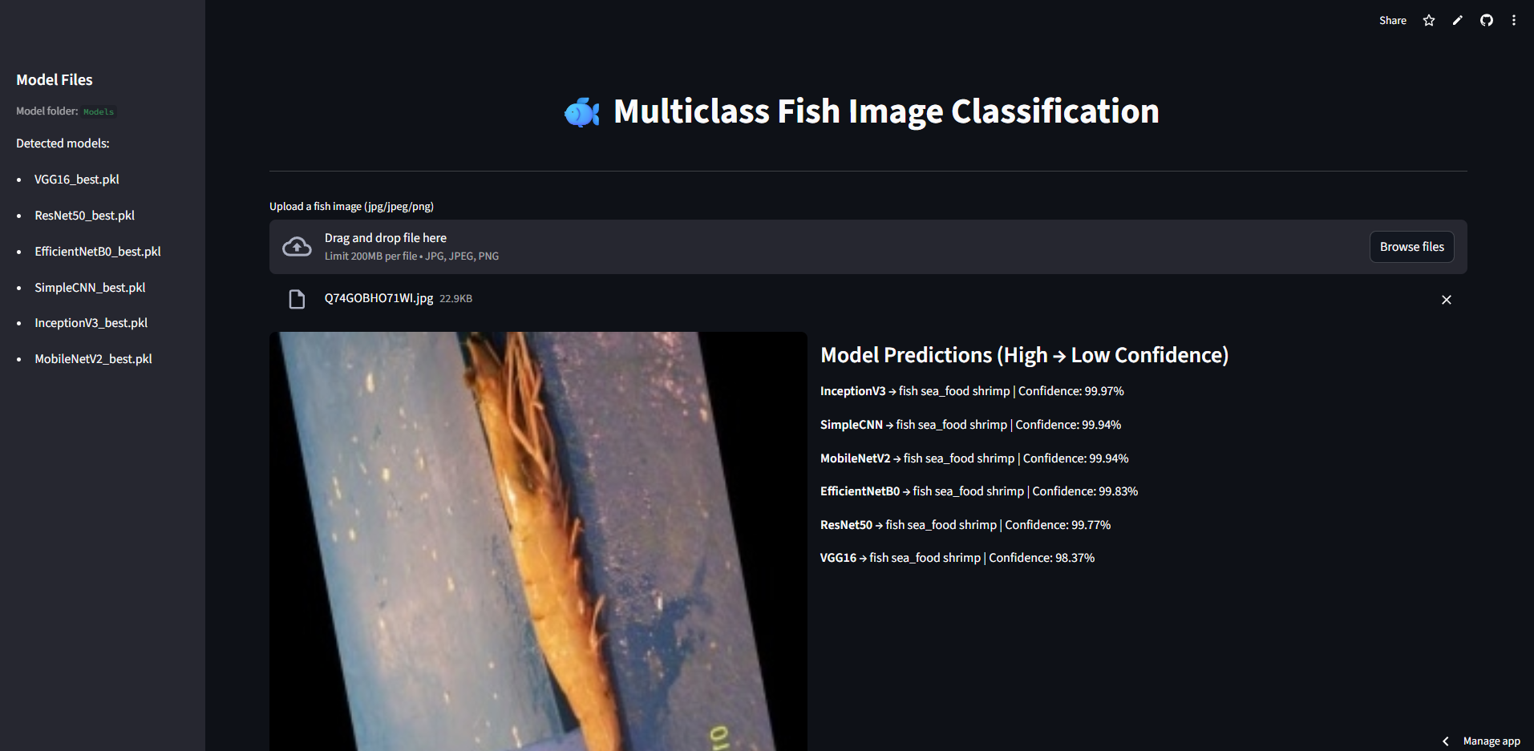
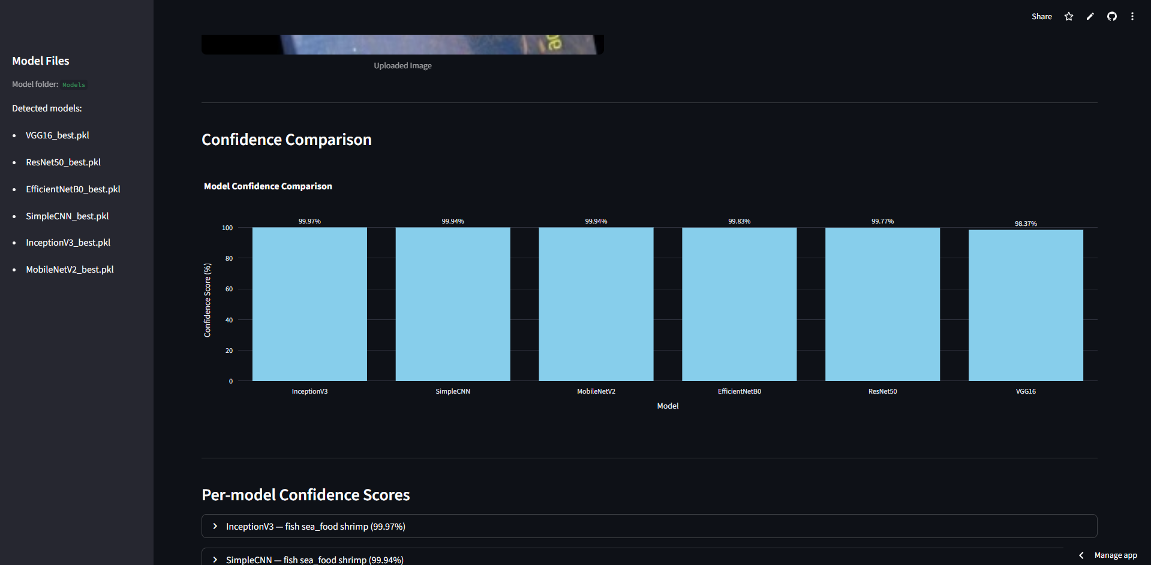
Screenshots

Slide 10
Conclusion & Insights
Pre-trained models outperform CNN from scratch
Data augmentation improves generalization
Best model deployed in Streamlit for interactive use
Future Improvements
Ensemble learning for better accuracy
Add more species or datasets for diversity
Multi-label classification (species + habitat)
Mobile deployment for real-time predictions

Slide 11
THANK YOU

